Slide 1


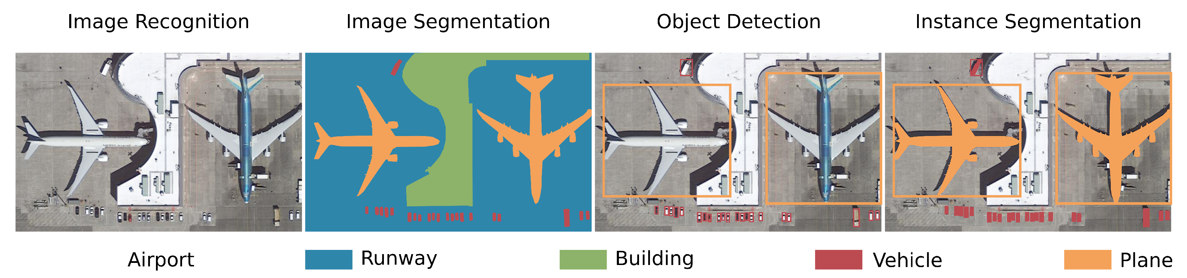
Εισαγωγή στην Κατάτμηση Εικόνας

Slide 2
Τι είναι η κατάτμηση;
Image segmentation is the operation of partitioning an image into a collection of connected sets of pixels.
Segmentation criteria: a segmentation is a partition of an image I into a set of regions S satisfying:
∪ S_{i} = S Partition covers the whole image.
S_{i} ∩ S_{j} = ∅, i ≠ j No regions intersect.
∀ S_{i}, P(S_{i}) = true Homogeneity predicate is satisfied by each region.
P(S_{i} ∪ S_{j}) = false, Union of adjacent regions i ≠ j, S_{i} adjacent S_{j} does not satisfy it.

Slide 3
Εμπειρικοί κανόνες (Gestalt laws)
Proximity: tokens that are nearby tend to be grouped.
Similarity: similar tokens tend to be grouped together.
Common fate: tokens that have coherent motion tend to be grouped together.
Common region: tokens that lie inside the same closed region tend to be grouped together.
Parallelism: parallel curves or tokens tend to be grouped together.
Closure: tokens or curves that tend to lead to closed curves tend to be grouped together.
Symmetry: curves that lead to symmetric groups are grouped together.
Continuity: tokens that lead to “continuous” curves tend to be grouped.
Familiar configuration: tokens that, when grouped, lead to a familiar object, tend to be grouped together.

Slide 4
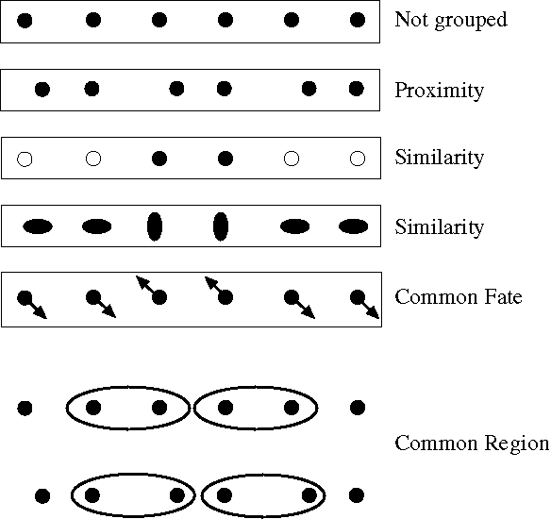
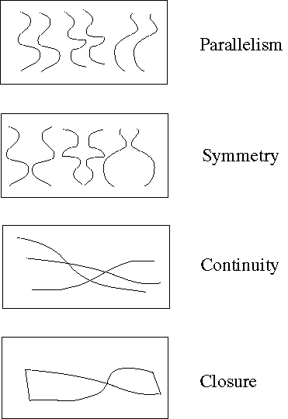
Στην πράξη

Slide 5
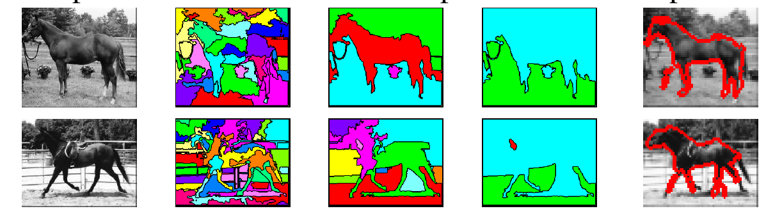
Segmentation types
Bottom-up: group tokens with similar features
Top-down: group tokens that likely belong to the same object

Slide 6
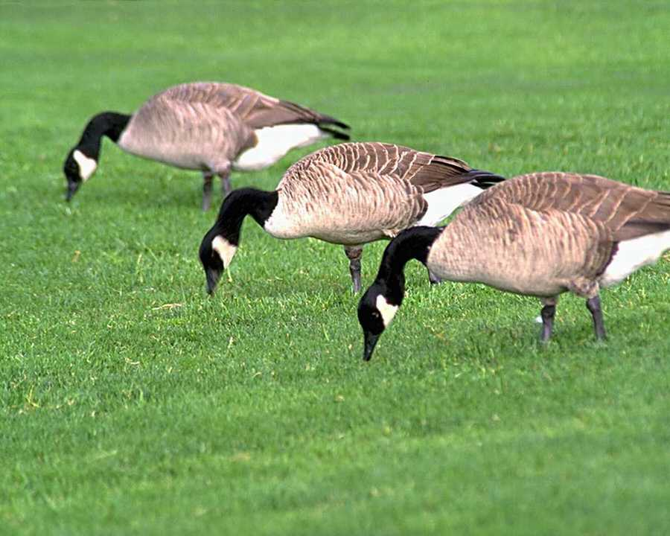
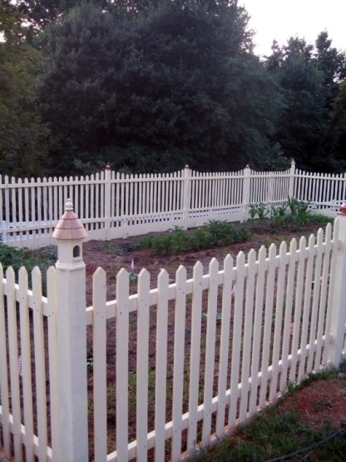
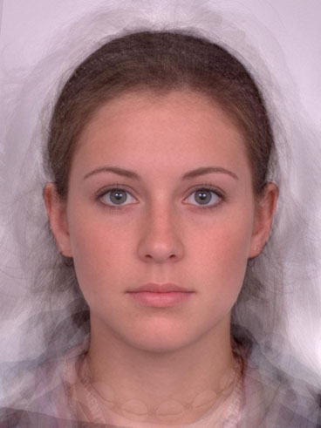
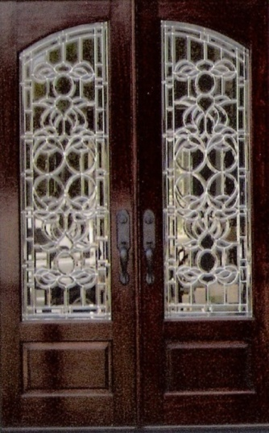
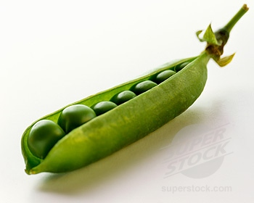
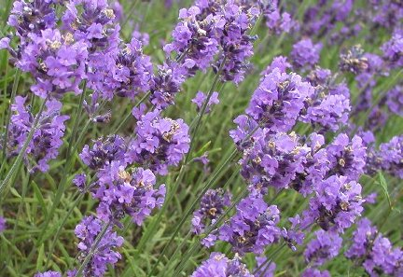
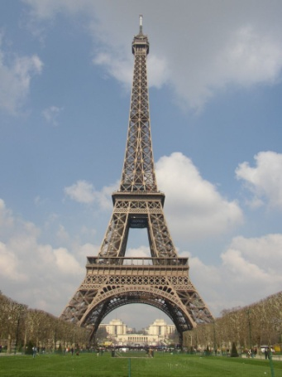
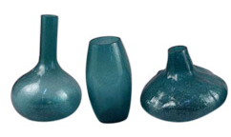
Μερικά παραδείγματα (1/3)
Similarity
Symmetry

Slide 7
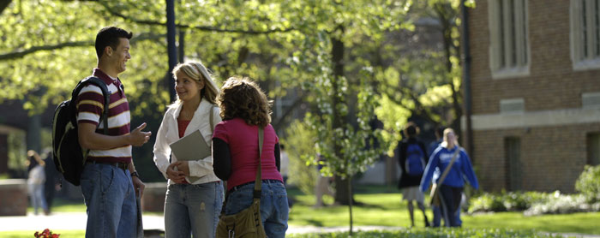
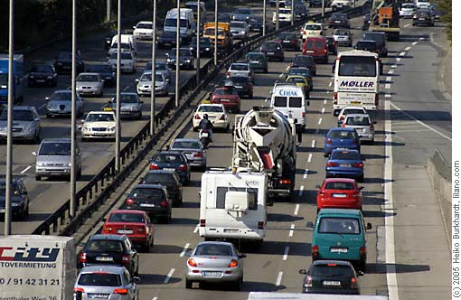
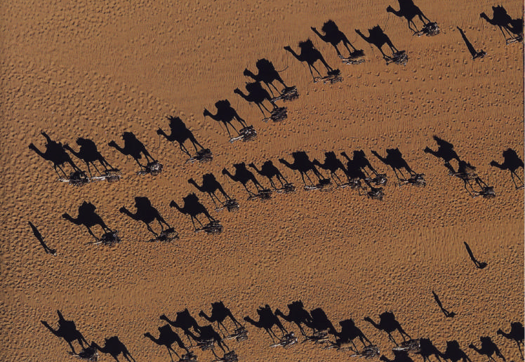

Μερικά παραδείγματα (2/3)
Proximity
Common fate

Slide 8
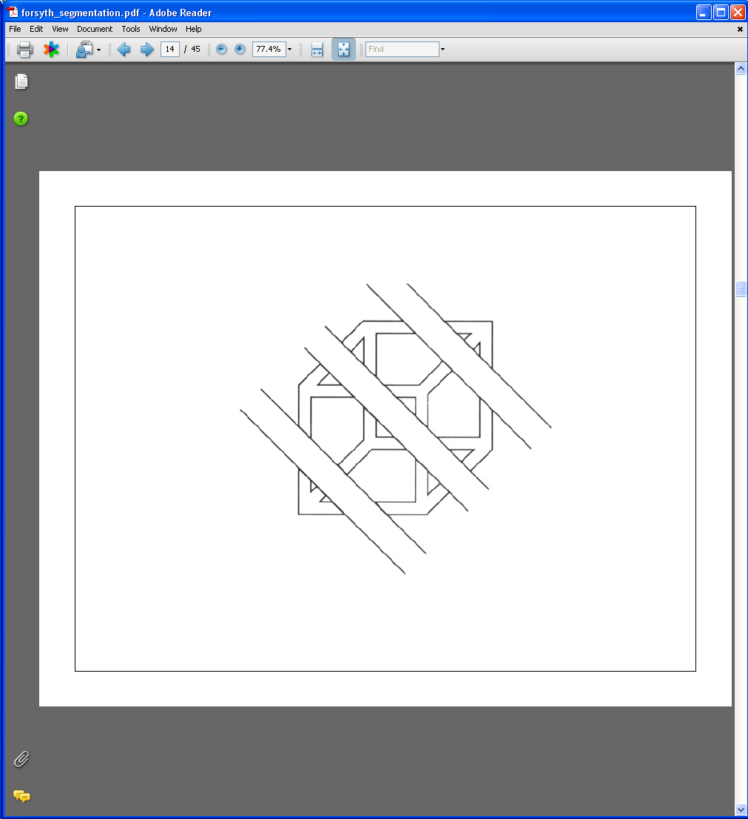
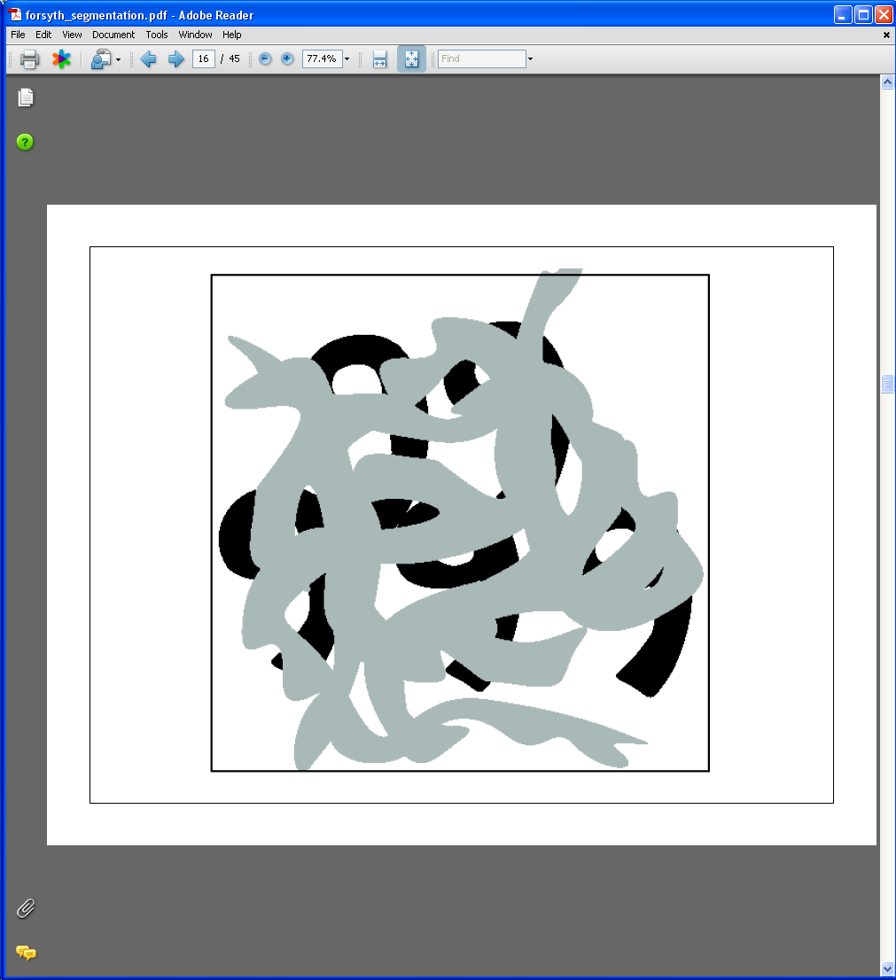
Μερικά παραδείγματα (3/3)
Continuity, explanation by occlusion

Slide 9
Why Segment?
Image simplification: an image may contain millions of pixels but only few regions
Similar pixels within a region tend to belong to the same class of object
Can provide the shape of an object
Regions are a higher level description of image content
To generate input for higher classification algorithms, e.g. Bayesian classifiers or Neural Networks
Semantic description of image content allows for efficient approximate matching in Content Based Image Retrieval systems

Slide 10
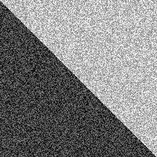

Υπενθύμιση στα γρήγορα
Image with Edge
Edge Location

Slide 11
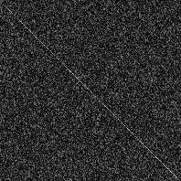

Η έννοια της παραχώρησης
Image + Noise
Derivatives detect edge and noise
Smoothed derivative removes noise, but blurs edge

Slide 12
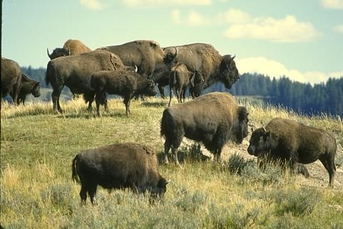
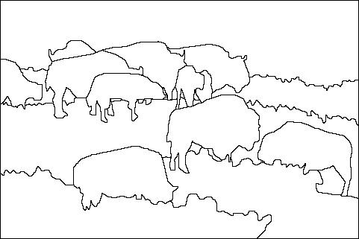
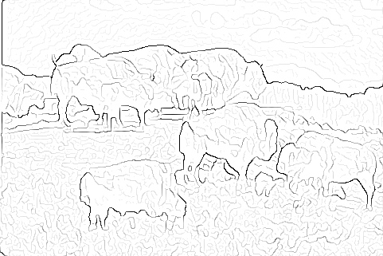

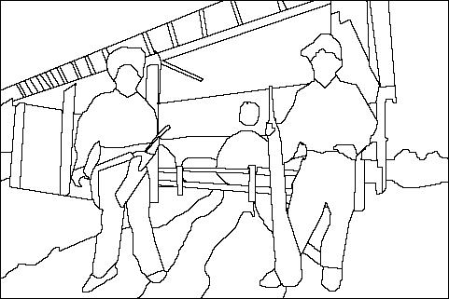
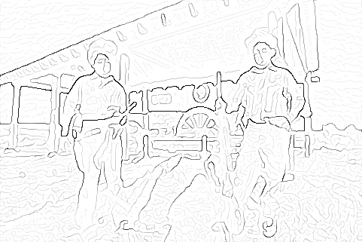
Από τις ακμές στην κατάτμηση
image
human segmentation
gradient magnitude
Berkeley segmentation database: http://www.eecs.berkeley.edu/Research/Projects/CS/vision/grouping/segbench/

Slide 13
Edge based segmentation
This approach identifies the strong edges in an image.
Hopefully these correspond to object boundaries.
Edges are extended or deleted so as to produce closed boundaries.
Termed "Edge Relaxation".
Only good for simple images.
Shape can then be used for recognition.
Notes:
A process similar to thresholding with hysteresis is edge relaxation. The idea of edge relaxation is not not simply add pixels if they are next to other edge pixels but to consider the context as well. In a sense, we are successively relaxing the criteria used to determine edge pixels, taking into account not just the properties of the pixel in question but of its neighbors as well. This process is called edge relaxation. In general, the term relaxation applies to any technique such as this that iteratively re-evaluates pixel classification.

Slide 14
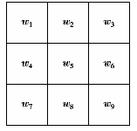
Detection of Discontinuities
detect the three basic types of gray-level discontinuities
points , lines , edges
the common way is to run a mask through the image

Slide 15
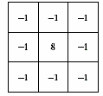
Point Detection
a point has been detected at the location on which the mask is centered if
|R| ≥ T
where
T is a nonnegative threshold
R is the sum of products of the coefficients with the gray levels contained in the region encompassed by the mark.

Slide 16
Point Detection
Note that the mask is the same as the Laplacian mask
The only differences that are considered of interest are those large enough (determined by T) to be considered isolated points.
|R| ≥ T

Slide 17
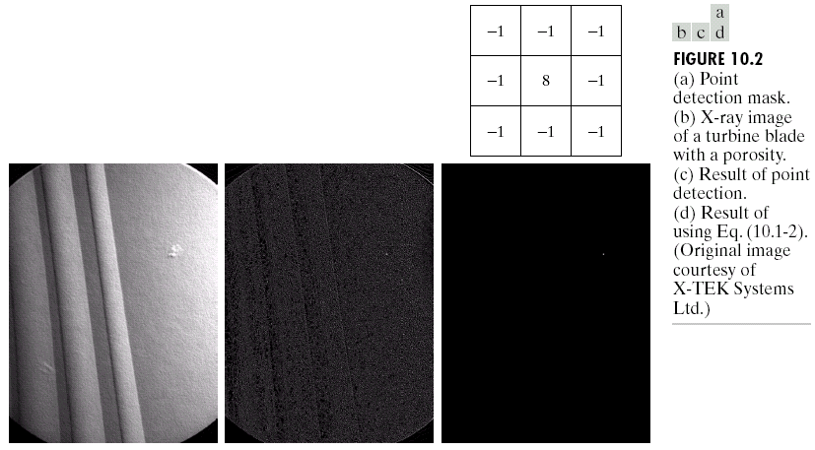
Example

Slide 18
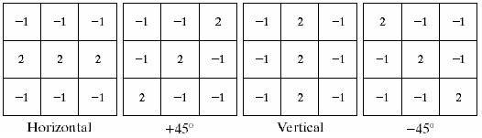
Line Detection
Line masks
Horizontal mask will have max response when a line of 1-pixel width passes through the middle row of the mask and when the background is constant. Similarly for the other masks.
Note: the preferred direction of each mask is weighted with a larger coefficient (i.e.,2) than other possible directions.
To detect dark lines we need R<T and T<0; to detect bright lines we set R>T>0; to detect all lines, set |R|>T>0.

Slide 19
Line Detection
Apply every mask on the image
let R₁, R₂, R₃, R₄ denote the response of the horizontal, +45 degrees, vertical and -45 degrees masks, respectively.
if, at a certain point in the image
|R_{i}| > |R_{j}|,
for all j≠i, that point is said to be more likely associated with a line in the direction of mask i.

Slide 20
Line Detection
Alternatively, if we are interested in detecting all lines in an image in the direction defined by a given mask, we simply run the mask through the image and threshold the absolute value of the result.
The points that are left are the strongest responses, which, for lines one pixel thick, correspond closest to the direction defined by the mask.

Slide 21
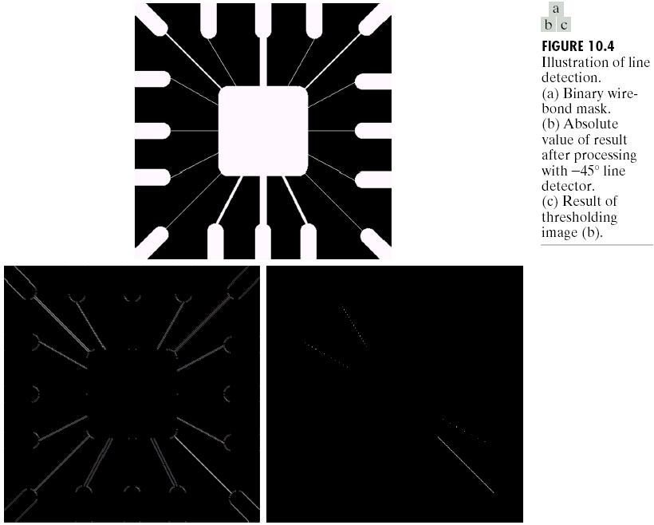
Example

Slide 22
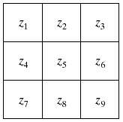
Edge Detection

Slide 23
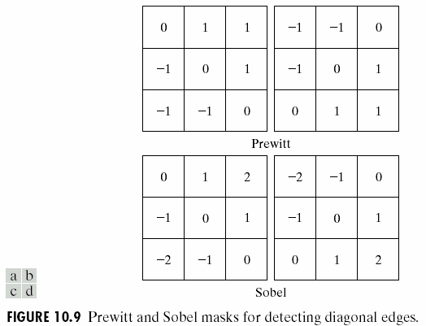
Detection of diagonal edges

Slide 24
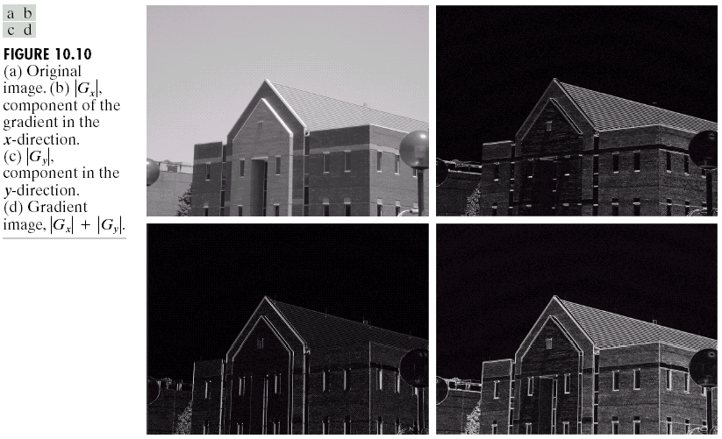
Edge Detection: Example

Slide 25
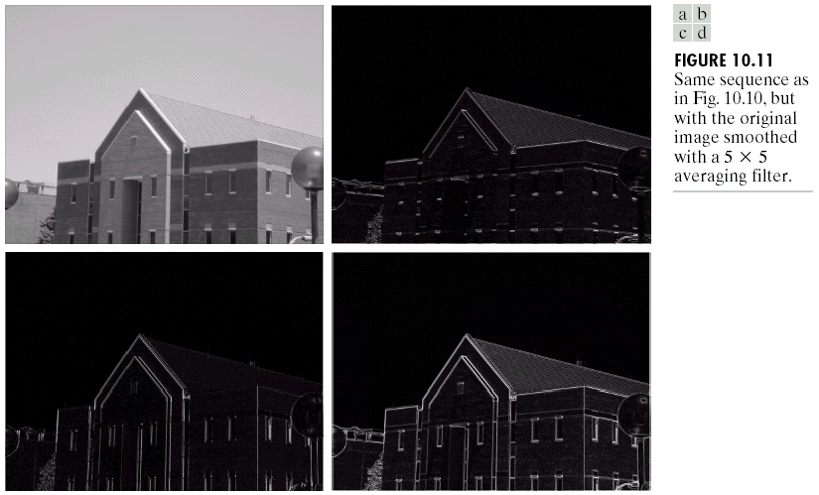
Edge Detection: Example

Slide 26
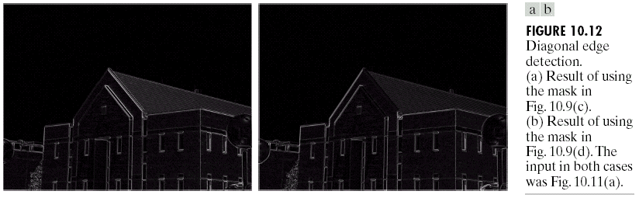
Edge Detection: Example

Slide 27
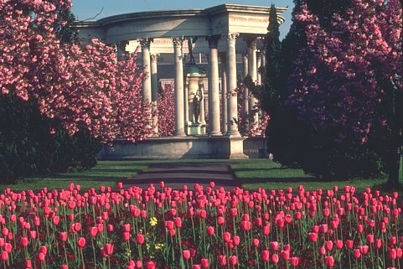
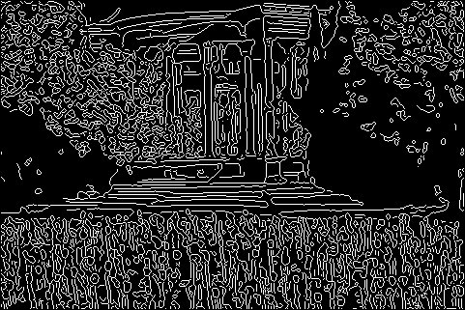
Συνήθως δεν εξυπηρετεί τον σκοπό

Slide 28


1. Histogram-based 2. Clustering-based 3. Region growing 4. Split-and-merge 5. Morphological 6. Graph-based
Τι άλλες τεχνικές έχω διαθέσιμες;

Slide 29
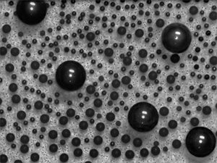
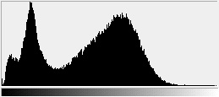
Histogram-based segmentation
How many modes are there?
Solve this by reducing the number of colors to K and mapping each pixel to the closest color.
Here’s what it looks like if we use two colors.

Slide 30
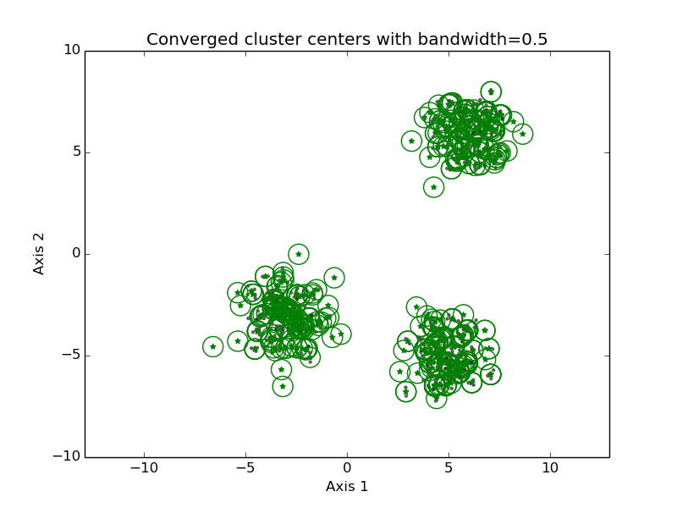
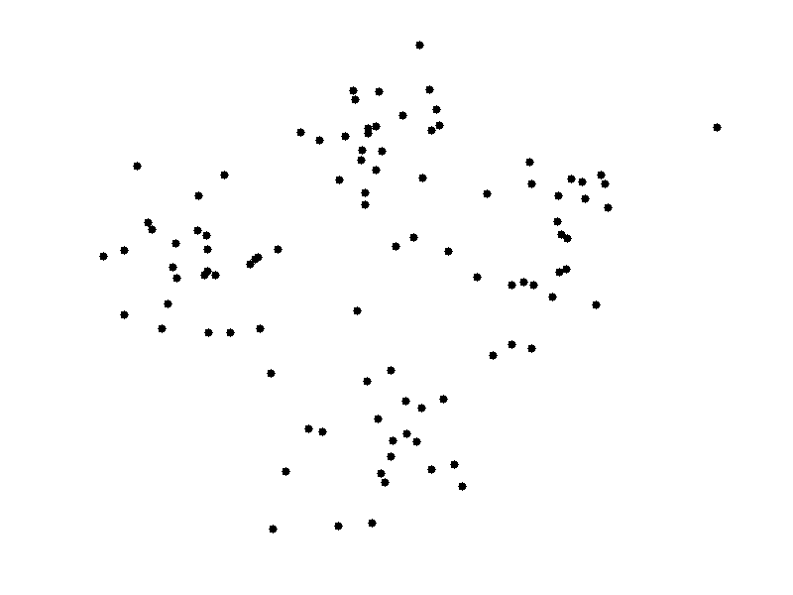
Συσταδοποίηση & κατάτμηση
K-Means
Mean Shift

Slide 31
Τιμές εισόδου

Slide 32
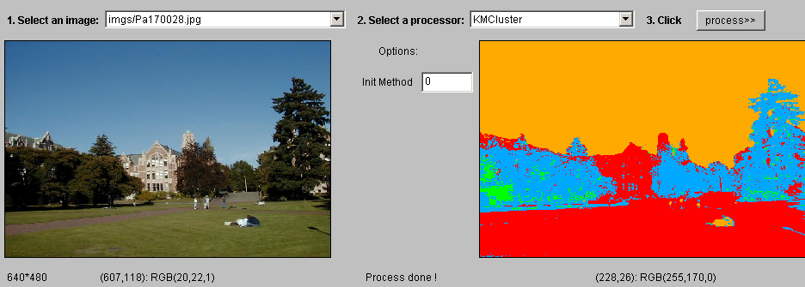
k-means segmentation
K-means clustering of color.

Slide 33
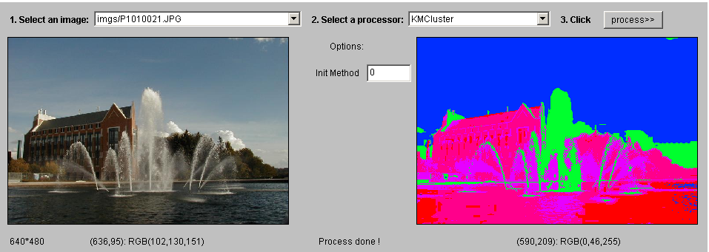
k-means segmentation
K-means clustering of color.

Slide 34
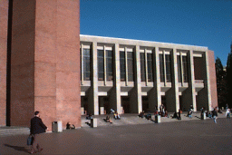
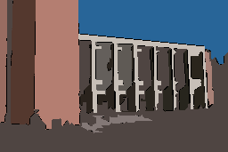
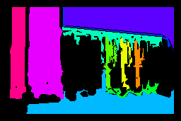
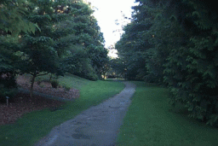
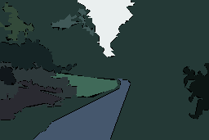
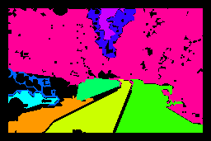
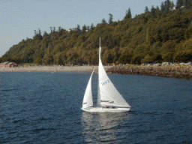

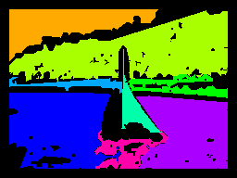
Εκτός από χρώμα, τι άλλο έχω;
Original Images
Color Regions
Texture Regions

Slide 35


+ και -
Pros:
Simple, fast to compute
Converges to local minimum of within-cluster squared error
Cons:
Setting K?
Sensitive to initial centers
Sensitive to outliers
Detects spherical clusters

Slide 36
Υπάρχουν παραλλαγές;
K-means variants:
Different ways to initialize the means.
Different stopping criteria.
Dynamic methods for determining the right number of clusters (K) for a given image.
Problem: histogram-based and clustering-based segmentation using color/texture/etc. can produce messy/noisy regions. (Why?)
How can these be fixed?

Slide 37

Mean shift algorithm
The mean shift algorithm seeks modes or local maxima of density in the feature space.
Image
Feature space (L*u*v* color values)

Slide 38
Mean shift algorithm
Search window
Center of
mass
Mean Shift
vector

Slide 39
Mean shift algorithm
Search window
Center of
mass
Mean Shift
vector

Slide 40
Mean shift algorithm
Search window
Center of
mass
Mean Shift
vector

Slide 41
Mean shift algorithm
Search window
Center of
mass
Mean Shift
vector

Slide 42
Mean shift algorithm
Search window
Center of
mass
Mean Shift
vector

Slide 43
Mean shift algorithm
Search window
Center of
mass
Mean Shift
vector

Slide 44
Mean shift algorithm
Search window
Center of
mass

Slide 45

Mean shift clustering/segmentation
Find features (color, gradients, texture, etc)
Initialize windows at individual feature points
Perform mean shift for each window until convergence
Merge windows that end up near the same “peak” or mode

Slide 46



Mean shift segmentation results
http://www.caip.rutgers.edu/~comanici/MSPAMI/msPamiResults.html

Slide 47
+ και -
Pros:
Does not assume shape on clusters
One parameter choice (window size)
Generic technique
Find multiple modes
Cons:
Selection of window size
Does not scale well with dimension of feature space

Slide 48

Region growing (1/5)
Region growing techniques start with one pixel of a potential region and try to grow it by adding adjacent pixels till the pixels being compared are too dissimilar.
The first pixel selected can be just the first unlabeled pixel in the image or a set of seed pixels can be chosen (manually or automatically) from the image.
We need to define a measure of similarity between a pixel and a set of pixels as well as a rule that makes a decision for growing based on this measure.
https://mastromonaco.dev/projects/region-growing/

Slide 49
Region growing (2/5)
Usually a statistical test is used to decide which pixels can be added to a region.
Region is a population with similar statistics.
Use statistical test to see if neighbor on border fits into the region population.
Let R be the N pixel region so far and p be a neighboring pixel with gray tone y.
Define the mean X and scatter S² (sample variance) by

Slide 50
Region growing (3/5)
The T statistic is defined by
It has a T_{N-1} distribution if all the pixels in R and the test pixel p are independent and identically distributed Gaussians (i.i.d. assumption).

Slide 51
Region growing (4/5)
For the T distribution, statistical tables give us the probability Pr(T ≤ t) for a given degrees of freedom and a confidence level. From this, pick a suitable threshold t.
If the computed T ≤ t for desired confidence level, add p to region R and update the mean and scatter using p.
If T is too high, the value p is not likely to have arisen from the population of pixels in R. Start a new region.
Many other statistical and distance-based methods have also been proposed for region growing.

Slide 52




Region growing (5/5)
http://www.bigr.nl/website/static/research/regrow.html
http://www.mathworks.com/matlabcentral/fileexchange/
32532-region-growing-2d3d-grayscale
http://www.mathworks.com/matlabcentral/fileexchange/
19084-region-growing
http://www.creatis.insa-lyon.fr/~grenier/?p=172

Slide 53

Split-and-merge (1/3)
Start with the whole image.
If the variance is too high, break into quadrants.
Merge any adjacent regions that are similar enough.
Repeat steps 2 and 3, iteratively until no more splitting or merging occur.
→ Idea: good Results: blocky

Slide 54



Split-and-merge (2/3)

Slide 55

Split-and-merge (3/3)

Slide 56


Watershed segmentation (1/9)
The image can be interpreted as a topographic surface, with both valleys and mountains.
Three types of points can be considered:
Points belonging to a regional minimum.
Points at which a drop of water, if placed at the location of any of those points, would fall to a single minimum. → catchment basins
Points at which water would be equally likely to fall to more than one such minimum. → watershed lines

Slide 57
Watershed segmentation (2/9)
Assume that there is a hole in each minima and the surface is immersed into a lake.
The water will enter through the holes at the minima and flood the surface.
To avoid the water coming from two different minima to meet, a dam is built whenever there would be a merge of the water.
Finally, the only thing visible of the surface would be the dams. These dam walls are called the watershed lines.

Slide 58

Watershed segmentation (3/9)

Slide 59

Watershed segmentation (4/9)

Slide 60








Watershed segmentation (5/9)
A multi-scale segmentation can be obtained by iteratively smoothing the topographic surface

Slide 61
Watershed segmentation (6/9)
The key behind using the watershed transform for segmentation is this: change your image into another image whose catchment basins are the objects you want to identify.
Examples:
Distance transform can be used with binary images where the catchment basins correspond to the foreground components of interest.
Gradient can be used with grayscale images where the catchment basins should theoretically correspond to the homogeneous grey level regions of the image.

Slide 62
Watershed segmentation (7/9)
Binary image.
Distance transform of the complement of the binary image.
Watershed transform after complementing the distance transform, and forcing pixels that do not belong to the objects to be at –Inf.

Slide 63


Watershed segmentation (8/9)
A cell image.
Gradient of the cell image.

Slide 64






Watershed segmentation (9/9)
Multi-scale watershed segmentation of the cell image.

Slide 65
Graph-based segmentation (1/10)
An image is represented by a graph whose nodes are pixels or small groups of pixels.
The goal is to partition the nodes into disjoint sets so that the similarity within each set is high and across different sets is low.

Slide 66
Graph-based segmentation (2/10)
Let G = (V,E) be a graph. Each edge (u,v) has a weight w(u,v) that represents the similarity between u and v.
Graph G can be broken into 2 disjoint graphs with node sets A and B by removing edges that connect these sets.
Let cut(A,B) = Σ w(u,v).
One way to segment G is to find the minimum cut
u∈A, v∈B

Slide 67

Graph-based segmentation (3/10)
Problem with minimum cut: weight of cut proportional to number of edges in the cut; tends to produce small, isolated components.

Slide 68
Graph-based segmentation (4/10)
Shi and Malik proposed the normalized cut.
cut(A,B) cut(A,B)
Ncut(A,B) = --------------- + ---------------
assoc(A,V) assoc(B,V)
Normalized
cut
assoc(A,V) = Σ w(u,t) u∈A, t∈V
How much is A connected
to the graph as a whole

Slide 69
Graph-based segmentation (5/10)
A
B
2
2
2
2
2
2
2
2
1
4
3
1
2
2
2
3
3 3
Ncut(A,B) = ------- + ------
21 16

Slide 70
Graph-based segmentation (6/10)
Shi and Malik turned graph cuts into an eigenvector/eigenvalue problem.
Set up a weighted graph G=(V,E).
V is the set of (N) pixels.
E is a set of weighted edges (weight w_{ij} gives the similarity between nodes i and j).
Length N vector d: d_{i} is the sum of the weights from node i to all other nodes.
N x N matrix D: D is a diagonal matrix with d on its diagonal.
N x N symmetric matrix W: W_{ij} = w_{ij}.

Slide 71

Graph-based segmentation (7/10)
Let x be a characteristic vector of a set A of nodes.
x_{i} = 1 if node i is in a set A
x_{i} = -1 otherwise
Let y be a continuous approximation to x
Solve the system of equations (D – W) y = λ D y for the eigenvectors y and eigenvalues λ.
Use the eigenvector y with second smallest eigenvalue to bipartition the graph (y → x → A).
If further subdivision is merited, repeat recursively.

Slide 72

Graph-based segmentation (8/10)
Edge weights w(i,j) can be defined by $w\left(i,j\right)=e^{{−\left\|F\left(i\right)−F\left(j\right)\right\|}^{2}/σ_{I}^{2}}⋅\left\{\begin{aligned}e^{{−\left\|X\left(i\right)−X\left(j\right)\right\|}^{2}/σ_{x}^{2}} \\ 0\end{aligned}\right.$
where
X(i) is the spatial location of node I
F(i) is the feature vector for node I which can be intensity, color, texture, motion…
The formula is set up so that w(i,j) is 0 for nodes that are too far apart.
if ||X(i)-X(j)||² < r
otherwise

Slide 73

Graph-based segmentation (9/10)

Slide 74
+ και -
Pros:
Generic framework, flexible to choice of function that computes weights (“affinities”) between nodes
Does not require model of the data distribution
Cons:
Time complexity can be high
Dense, highly connected graphs → many affinity computations
Solving eigenvalue problem

Slide 75

The end!
Questions?

